Slide 1
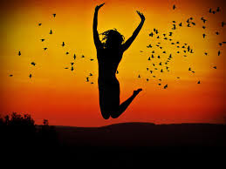
LO: To write a group poem about happiness.
Steps to success:
I can say what makes me feel happy.
I can recognise and sort different
emotion faces.
I can write a sentence for a group poem.

Slide 2
Show me a happy face!

Slide 3
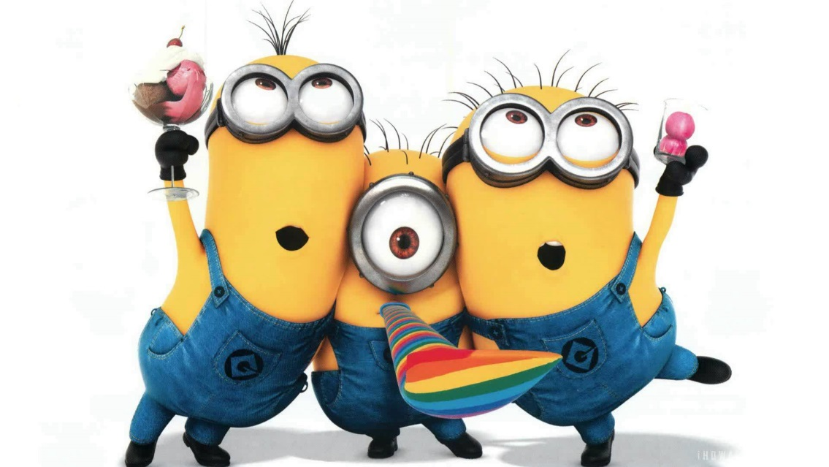
What makes you feel happy?

Slide 4
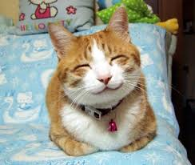
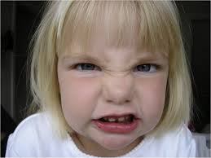
Activity 1: Sort the different faces into…
Happy faces
Sad faces
Angry faces

Slide 5
Activity 2: Write a sentence about what makes you feel happy
We are children We are happy Happy in this world But not so happier Than the butterflies Fly among the flowers. We are children We are happy Happy in this world

Slide 6
Happy is…
Happy is dancing in the rain…

